Slide 1
BRAIN MRI SEGMENTATION USING RESNET-50 AND TVERSKY METRIC
TEAM :
AKSHAYA N
NARMATHA T
NAKSHATRA SINGH
NAMITHA K
PRARTHANA G

Slide 2
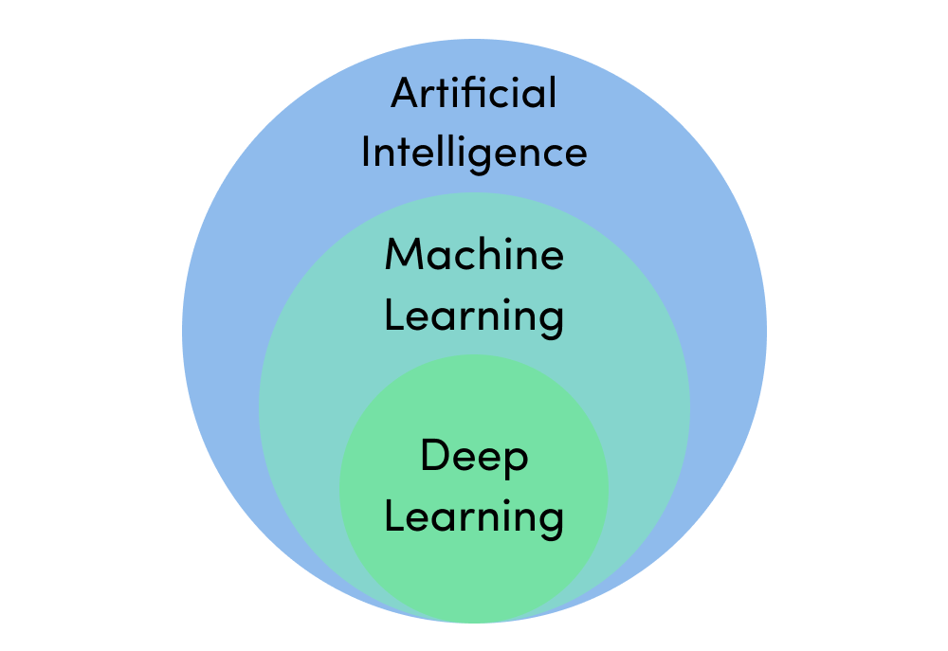
INTRODUCTION TO DOMAIN - DEEP LEARNING
Deep learning is a subset of machine learning in artificial intelligence that has networks capable of learning unsupervised from data that is unstructured or unlabeled. Also known as deep neural learning or deep neural network.
Deep learning is an AI function that mimics the workings of the human brain in processing data for use in detecting objects, recognizing speech, translating languages, and making decisions.

Slide 3
MOVING FURTHER - DEEP LEARNING
Deep learning has evolved hand-in-hand with the digital era, which has brought about an explosion of data in all forms and from every region of the world. This data, known simply as big data, is drawn from sources like social media, internet search engines, e-commerce platforms, and online cinemas, among others. This enormous amount of data is readily accessible and can be shared through fintech applications like cloud computing.
Deep learning unravels huge amounts of unstructured data that would normally take humans decades to understand and process.
Deep learning utilizes a hierarchical level of artificial neural networks to carry out the process of machine learning. The artificial neural networks are built like the human brain, with neuron nodes connected together like a web. While traditional programs build analysis with data in a linear way, the hierarchical function of deep learning systems enables machines to process data with a nonlinear approach.

Slide 4
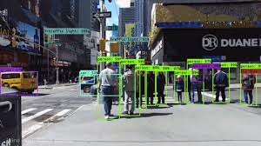
INTRODUCTION TO DOMAIN-CV
Computer vision is concerned with the automatic extraction, analysis and understanding of useful information from a single image or a sequence of images. It involves the development of a theoretical and algorithmic basis to achieve automatic visual understanding.
As a scientific discipline, computer vision is concerned with the theory behind artificial systems that extract information from images.
The image data can take many forms, such as video sequences, views from multiple cameras, or multi-dimensional data from a medical scanner.
As a technological discipline, computer vision seeks to apply its theories and models for the construction of computer vision systems.

Slide 5
UNDERSTANDING OF THE DOMAIN
Brain tumor segmentation is the process of separating the tumor from normal brain tissues; in clinical routine, it provides useful information for diagnosis and treatment planning. Timely diagnosis of brain tumors is thus vital to ensuring appropriate treatment planning, surgery, and follow-up visits . As a popular non-invasive technique Magnetic Resonance Imaging (MRI) produces markedly different types of tissue contrast and has thus been widely used by radiologists to diagnose brain tumors However, the manual segmentation of brain tumors from MRI images is both subjective and time-consuming. Therefore, it is highly desirable to design automatic and robust brain tumor segmentation tools.

Slide 6
DEEP LEARNING
Deep learning becomes an attractive field of machine learning that outperforms traditional computer vision algorithms in a wide range of applications such as object detection semantic segmentation as well as other applications such as navigation guidance.
Convolutional neural networks (CNNs) have proved during the ImageNet Large-Scale Visual Recognition Challenge (ILSVRC) and their ability to accurately detect and localize different types of objects
The developed DeepSeg is a modular decoupling framework. It consists of two connected core parts based on an encoding and decoding relationship.
The encoder part is a convolutional neural network (CNN) responsible for spatial information extraction. The resulting semantic map is inserted into the decoder part to get the full-resolution probability map. Based on modified U-Net architecture, different CNN models such as residual neural network (ResNet), dense convolutional network (DenseNet), and NASNet have been utilized in this study.

Slide 7
DENSENET
A DenseNet is a type of convolutional neural network that utilises dense connections between layers, through Dense Blocks, where we connect all layers (with matching feature-map sizes) directly with each other. To preserve the feed-forward nature, each layer obtains additional inputs from all preceding layers and passes on its own feature-maps to all subsequent layers.
DenseNets have several compelling advantages: they alleviate the vanishing-gradient problem, strengthen feature propagation, encourage feature reuse, and substantially reduce the number of parameters.It is possible for the DenseNet to suppress irrelevant regions in brain MR images while highlighting useful salient features

Slide 8
RESNET-50
ResNet, short for Residual Networks is a classic neural network used as a backbone for many computer vision tasks.ResNet-50 is a convolutional neural network that is 50 layers deep. You can load a pretrained version of the network trained on more than a million images from the ImageNet database . The pretrained network can classify images into 1000 object categories, such as keyboard, mouse, pencil, and many animals. As a result, the network has learned rich feature representations for a wide range of images
Experimental results show that the Resnet-50 model achieves the highest accuracy and least false negative rates as 95% and zero respectively.

Slide 9
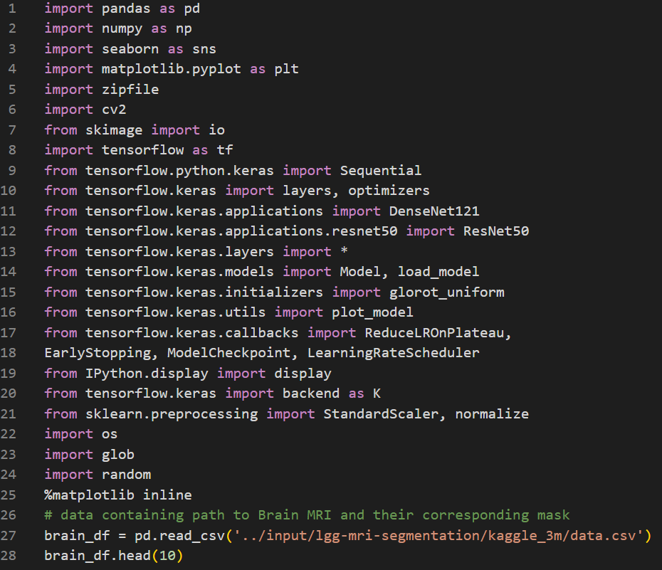
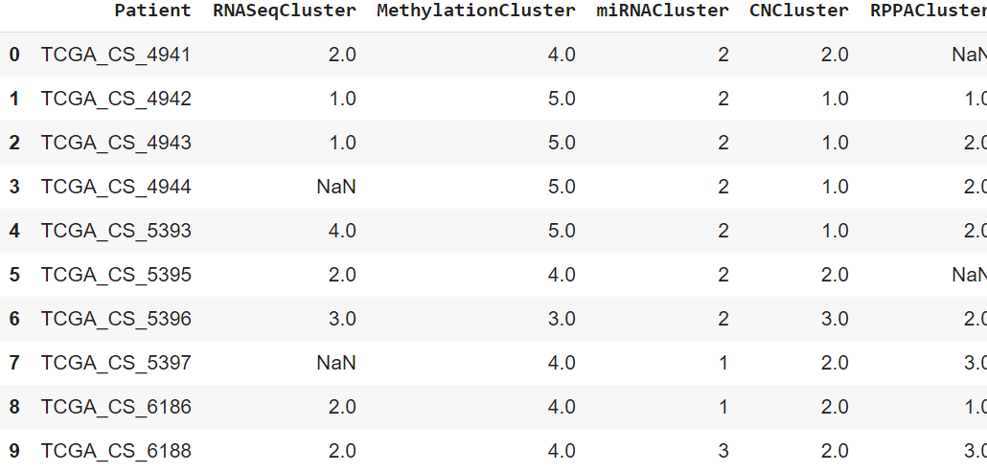
CODE
Importing libraries to perform EDA (Exploratory data analysis) along with Tensorflow modules.
Storing data in a dataframe for further analysis.

Slide 10
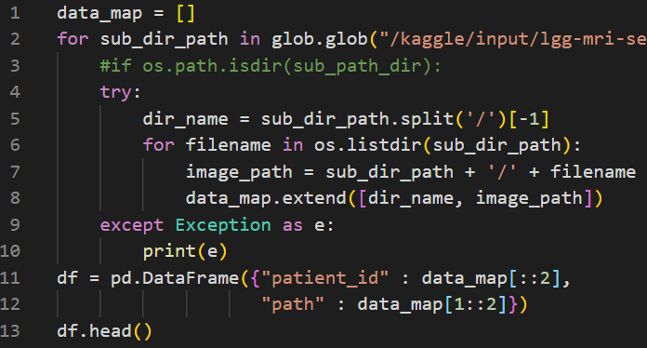
CODE
Preprocessing, setting up model hyper-parameters
Further, the filepaths of masks and images will be acquired.

Slide 11
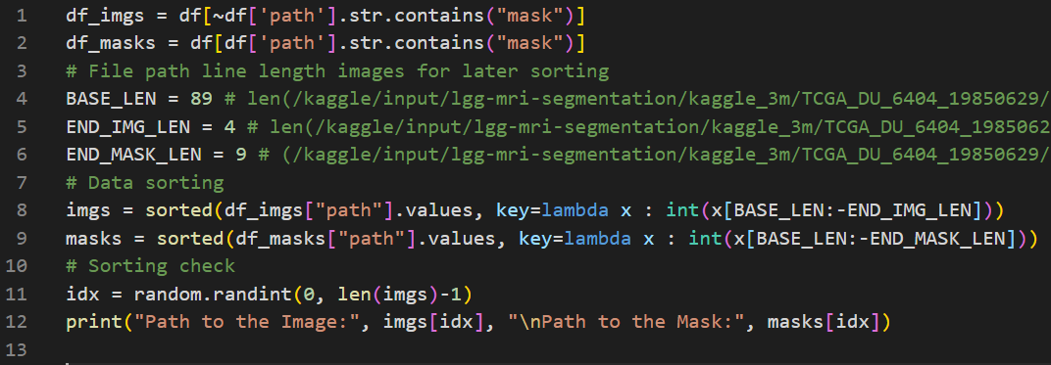
CODE
Data sorting and sorting confirmation

Slide 12
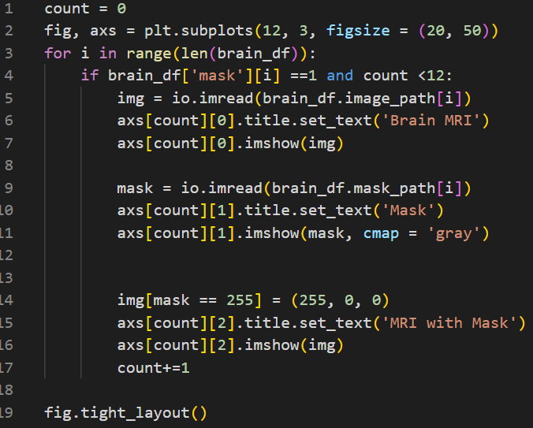
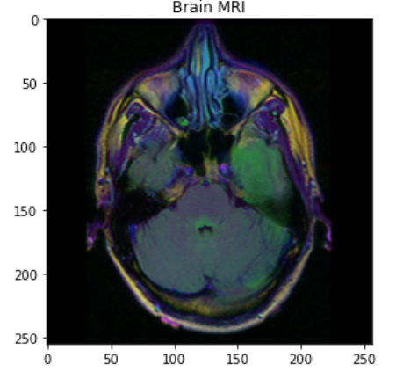
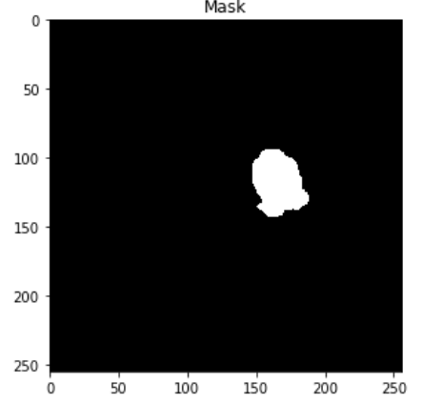
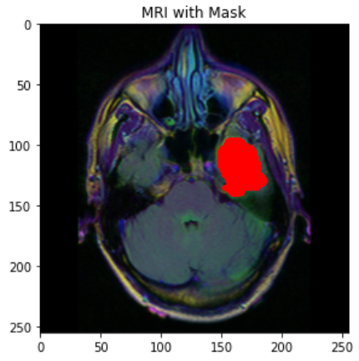
CODE
Data visualization of MRI's and masks in the dataset

Slide 13
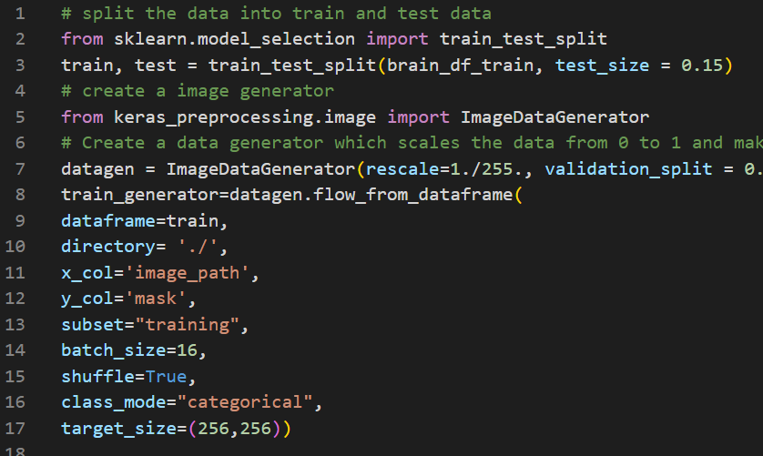
CODE
Training the classifier model using train and test data
Use Kera's image data generator to scale data from 0 to 1
Making basemodel using Resnet50

Slide 14
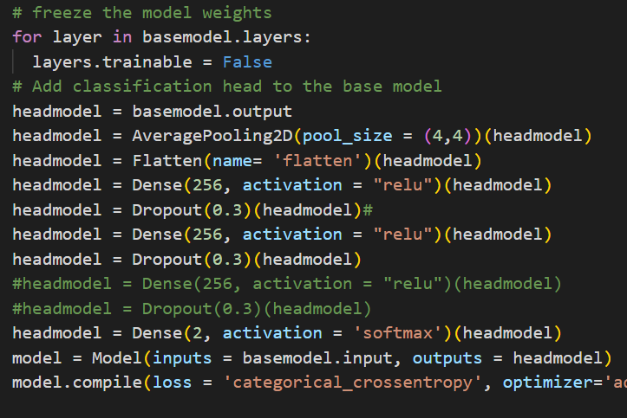
CODE
Add a classifier head to the base model
Compile and save the best model with the least validation loss in a JSON file for future use

Slide 15
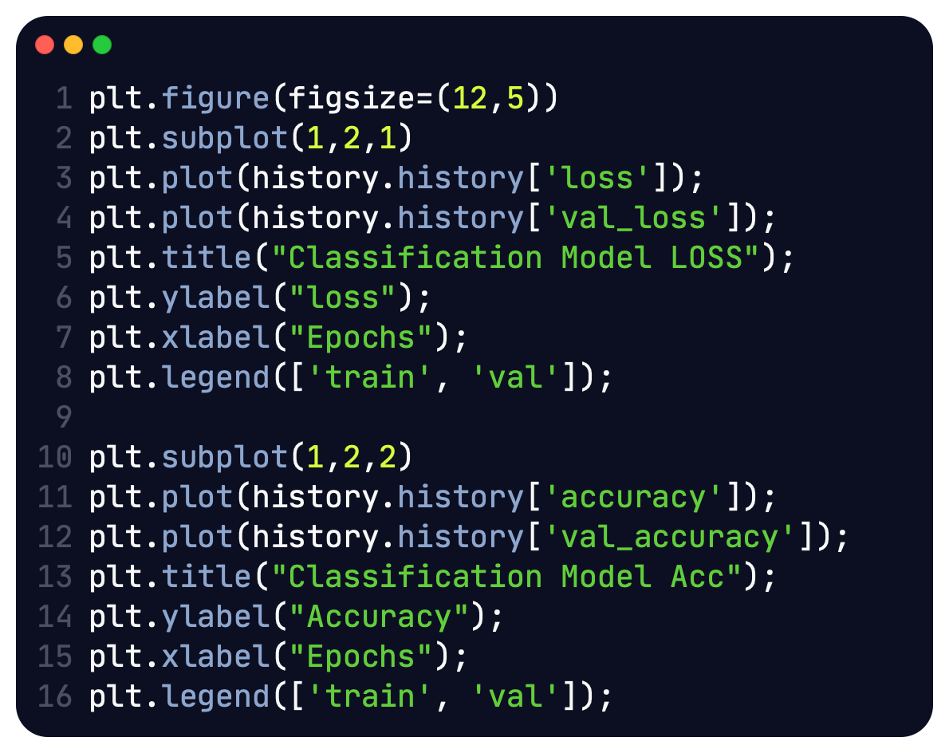
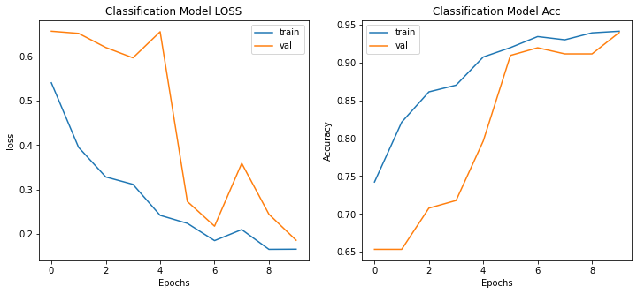
CODE
Evaluation metric visualization
using MatPlotLib. (Accuracy and Loss)
Vanilla Convolutional Neural Network
results.

Slide 16
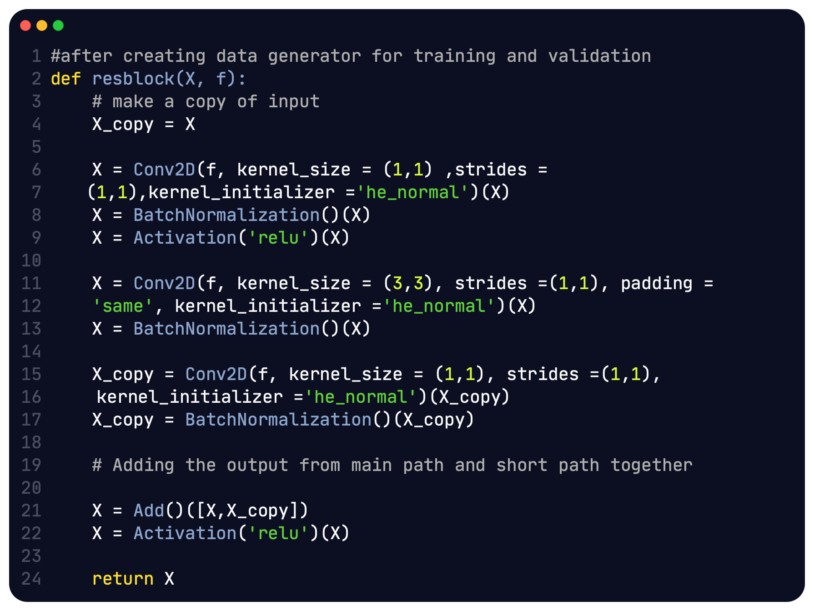
CODE
We set up training and
Validation sets using
Tensorflow data generators.
Custom Residual Block for
segmentation.

Slide 17
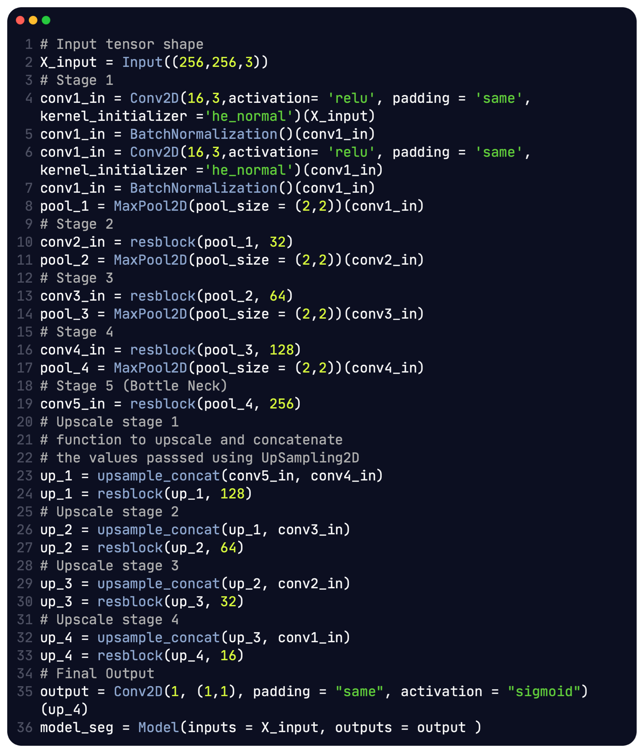
CODE
Model Architecture.

Slide 18
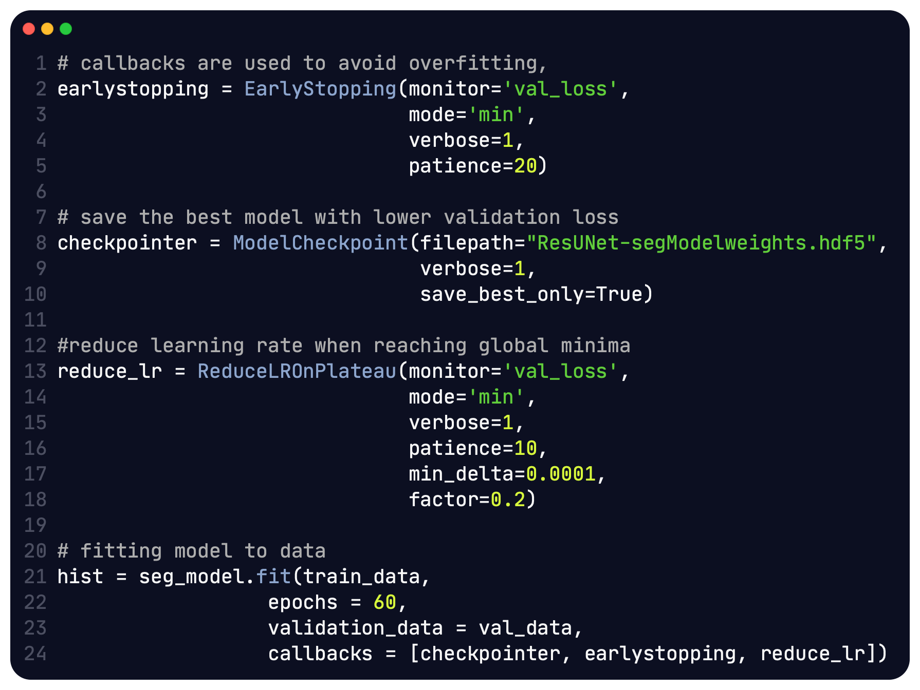
CODE
Training the custom
segmentation model.

Slide 19
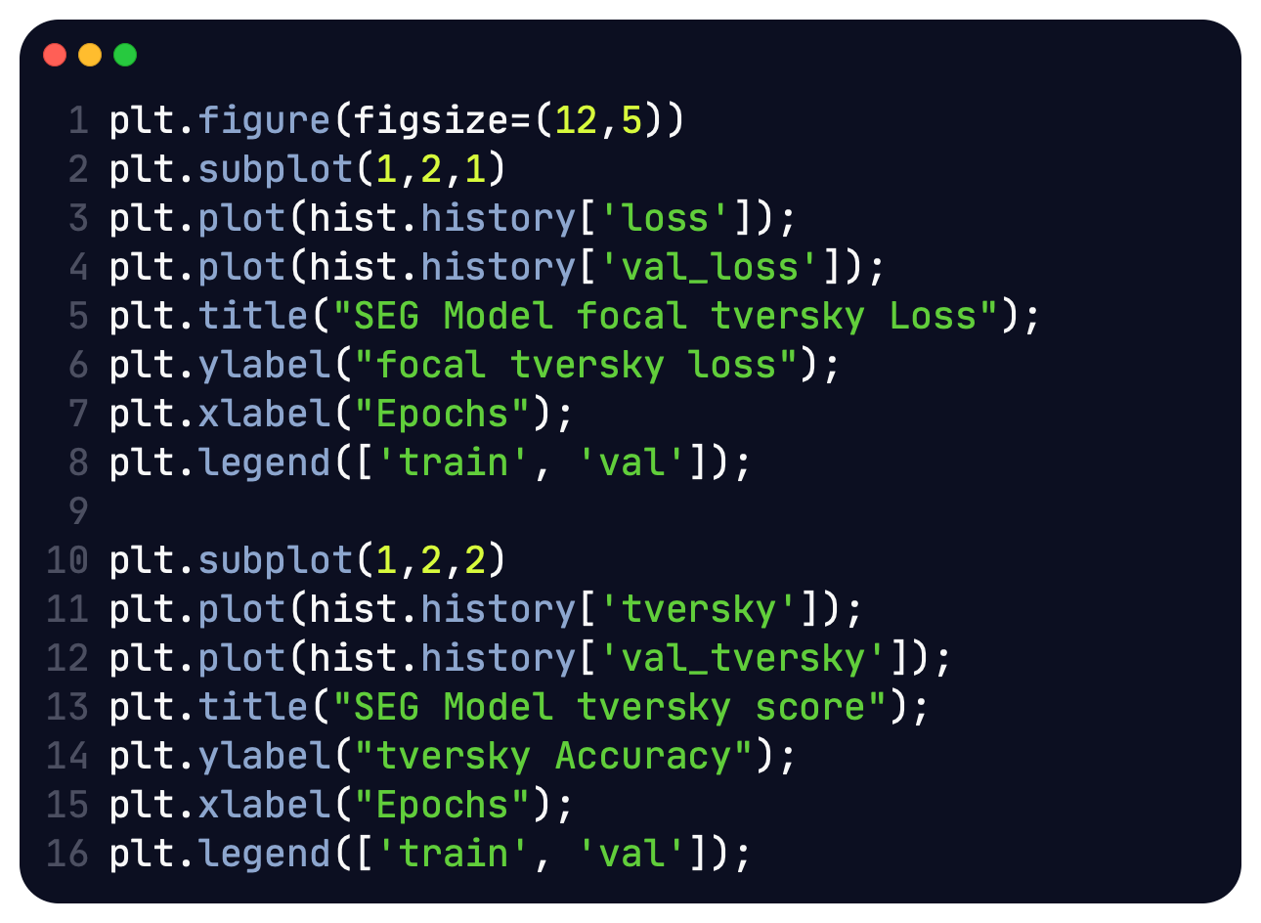
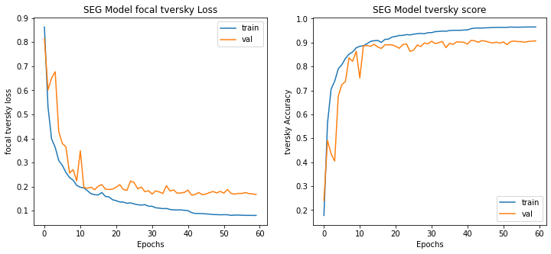
CODE
Evaluating segmentation ResUNet model
Using Tversky metric.

Slide 20
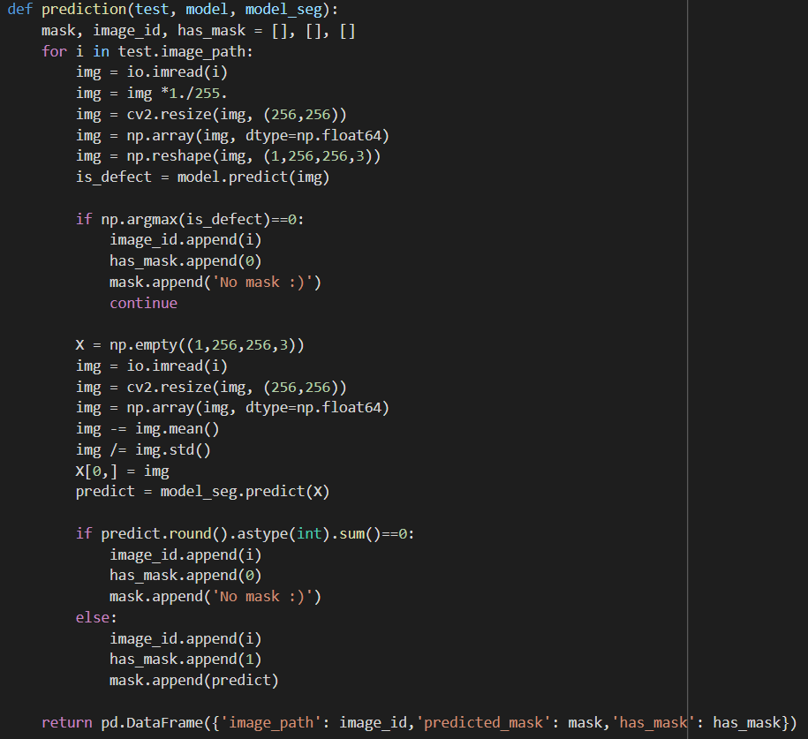
OUTPUT
Prediction function to
categorize if the image
has defect or no defect.

Slide 21
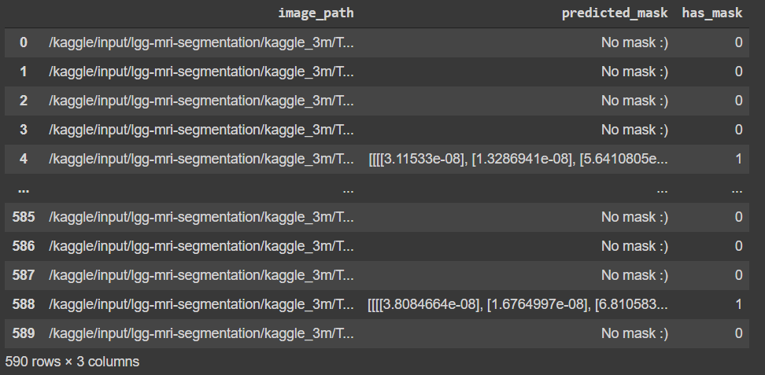
OUTPUT

Slide 22
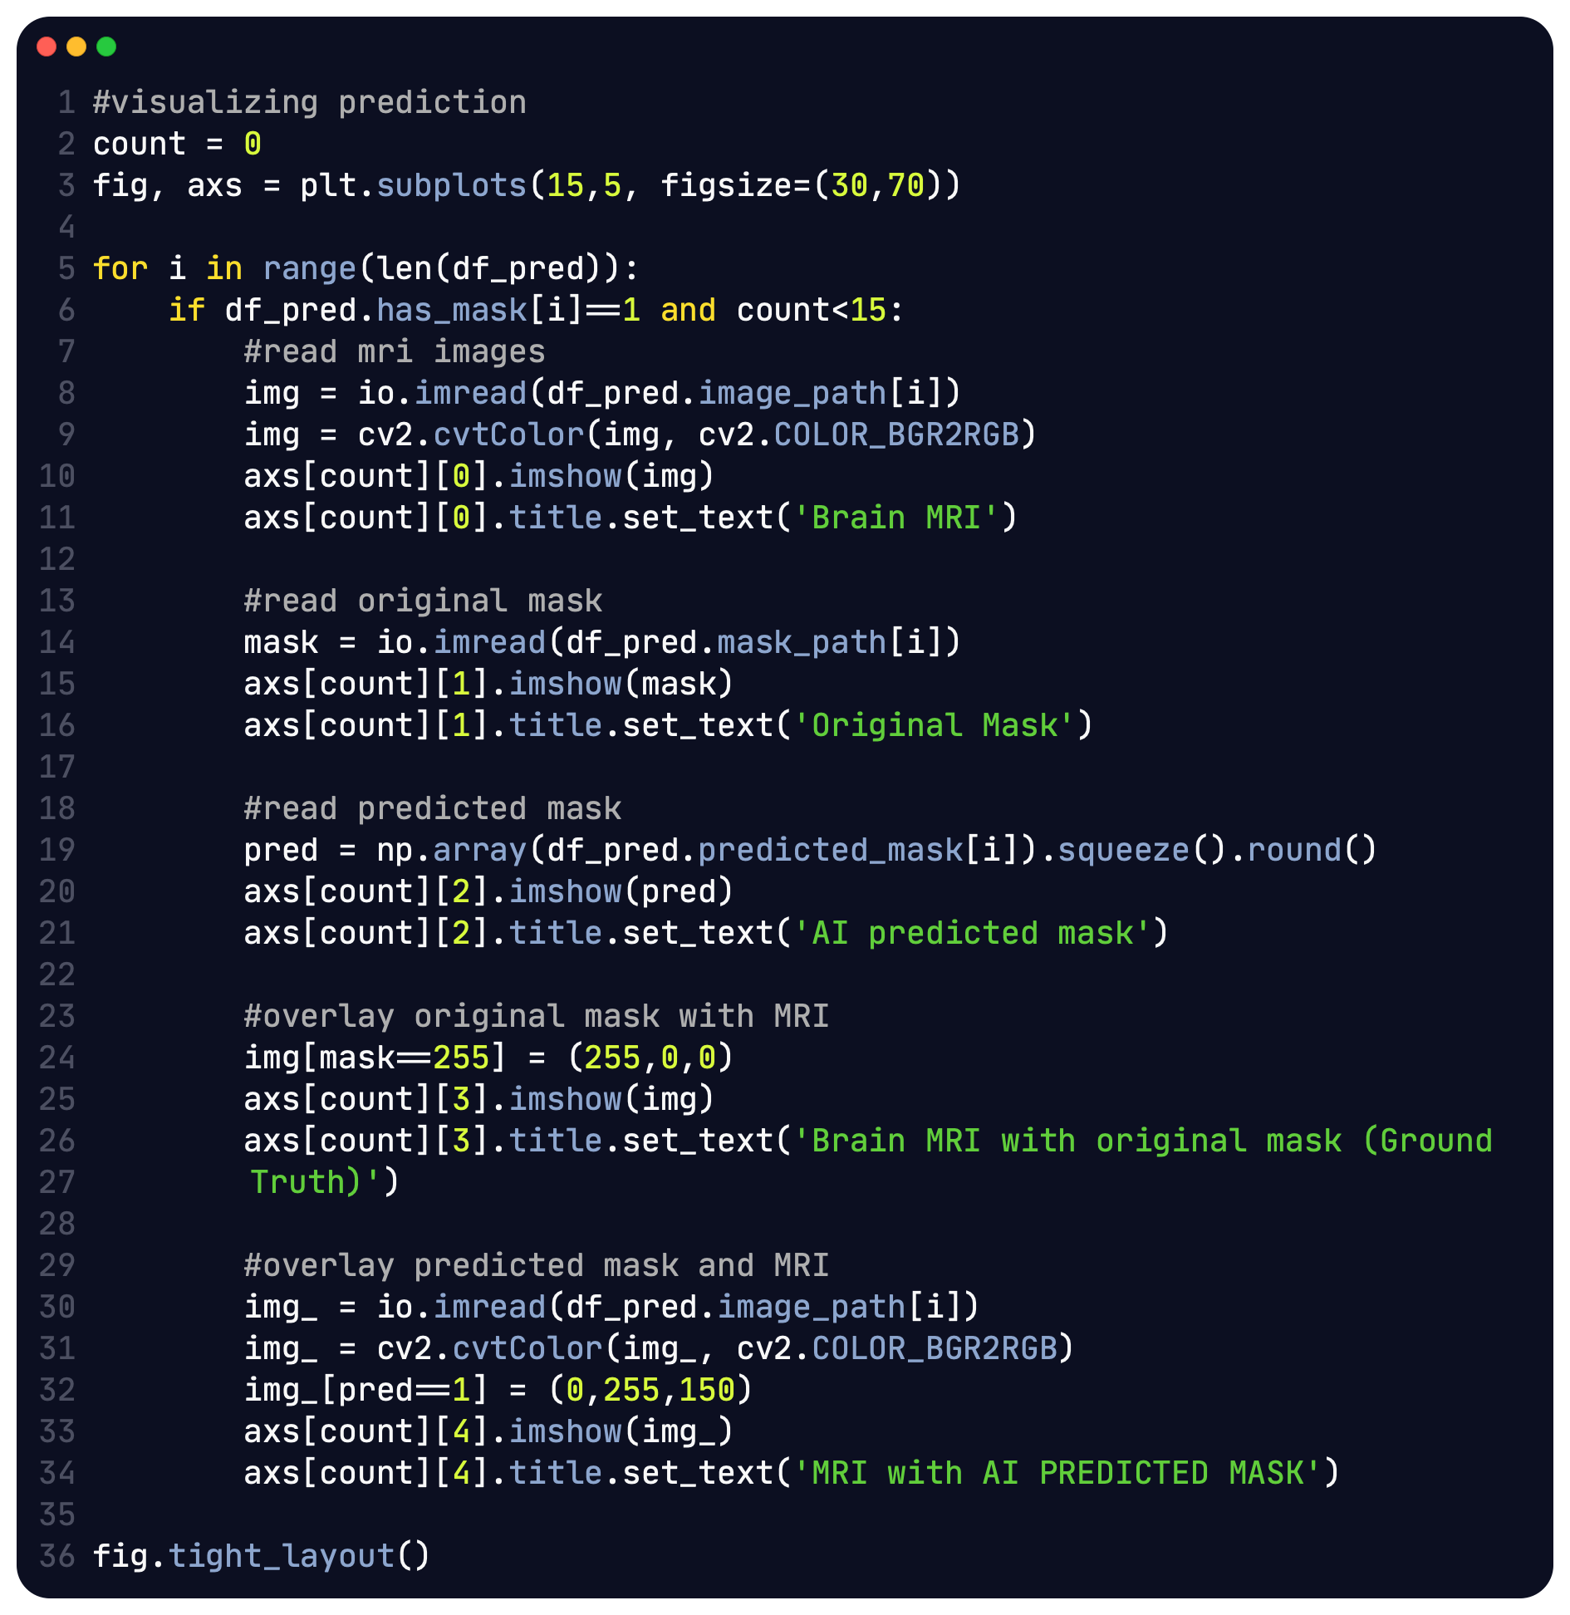
OUTPUT
Visualizing model results on
Test data and custom trained
ResUNet model.

Slide 23
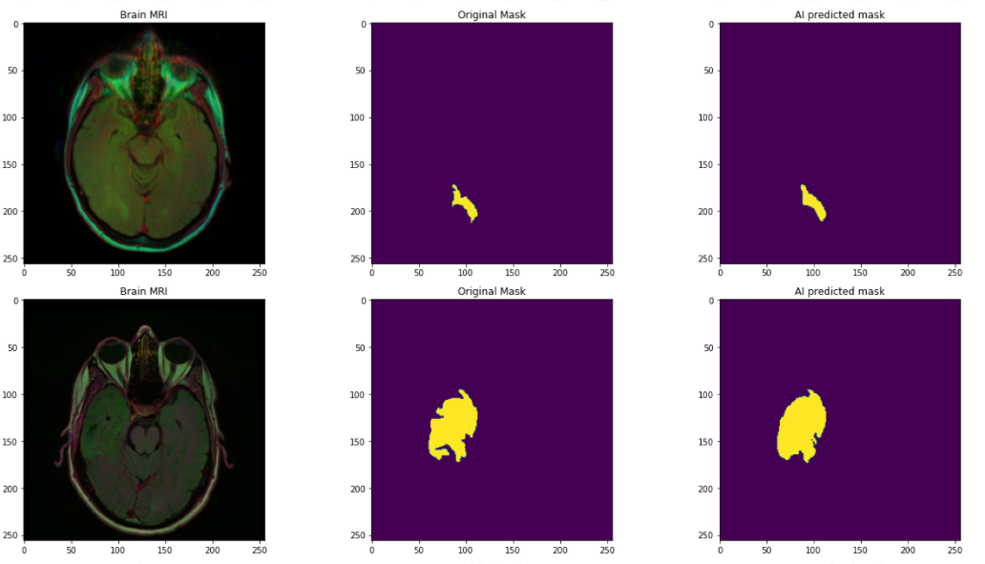
OUTPUT

Slide 24
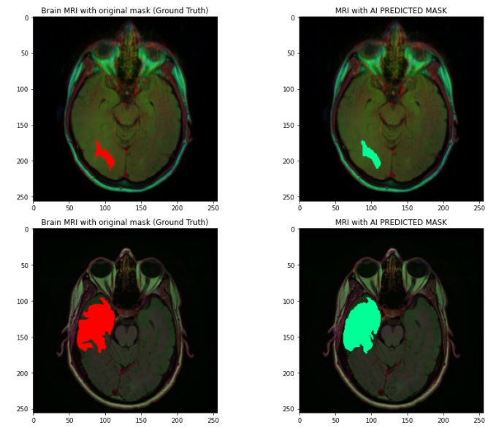
OUTPUT

Slide 25
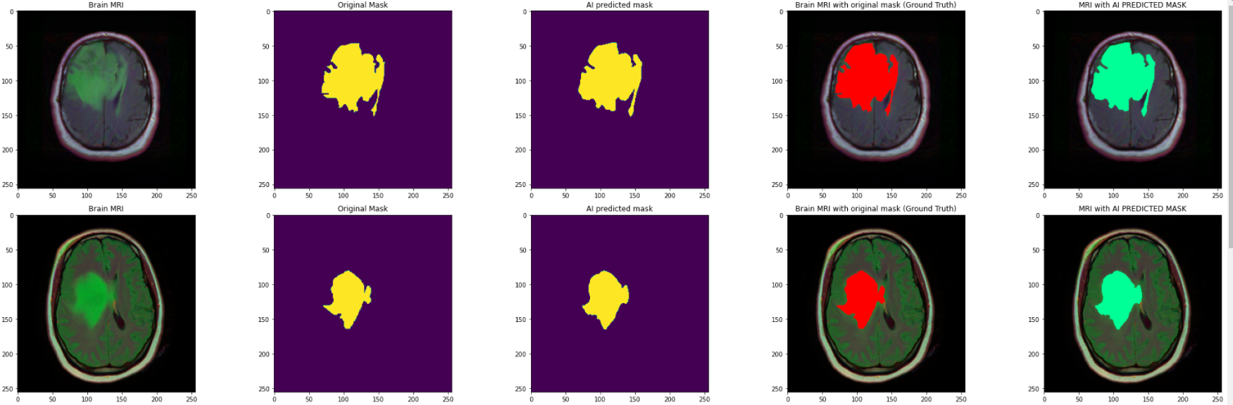
OUTPUT
VISUALIZING PREDICTION

Slide 26
THANK YOU

